Slide 1
Traffic Stop for Law Enforcement
Victor Ngoubayo
Swetha Thodupunori
Prince Ikegwuono
COSC 729 – Spring 2021

Slide 2
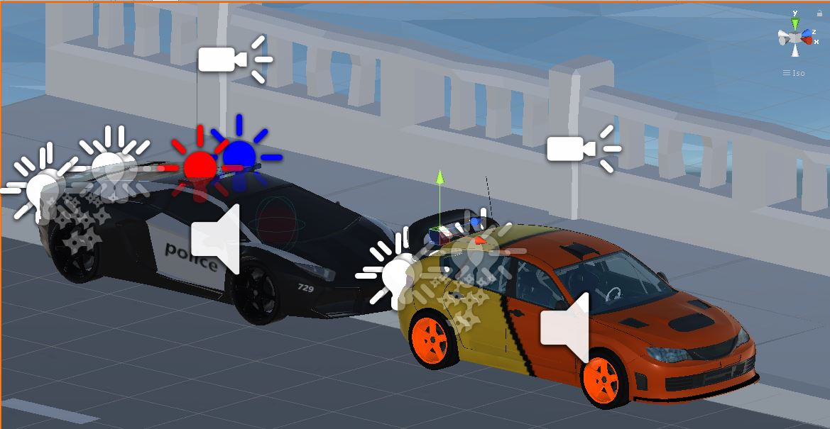

Slide 3
Goal and Objective
The project is a simulation of a law enforcement traffic stop from the driver and occupants’ point of view.
It encourages the user to experience the event first hand and to make decisions that may escalate or de-escalate the situation.

Slide 4
Why Virtual Reality?
Traffic stops are a routine operation of law enforcement. Most common interactions between a police officer and a civilian. Traffic stops are highly risky due to the uniqueness of each situation. A stop initiated for a simple reason may quickly escalate to a life and death situation.
This virtual reality simulation is developed to assist drivers and law enforcement with current traffic procedures.
Leverages the futuristic capabilities of immersive virtual reality experiences.
Education and Training.
Legal adjudication.
Entertainment.

Slide 5
Modeling and Environment
The envisioned virtual environment would a realistic replication of street or highway roads, including other drivers, pedestrians, traffic signs and buildings.
The environment would include a health bar and onscreen instructions for the user.

Slide 6
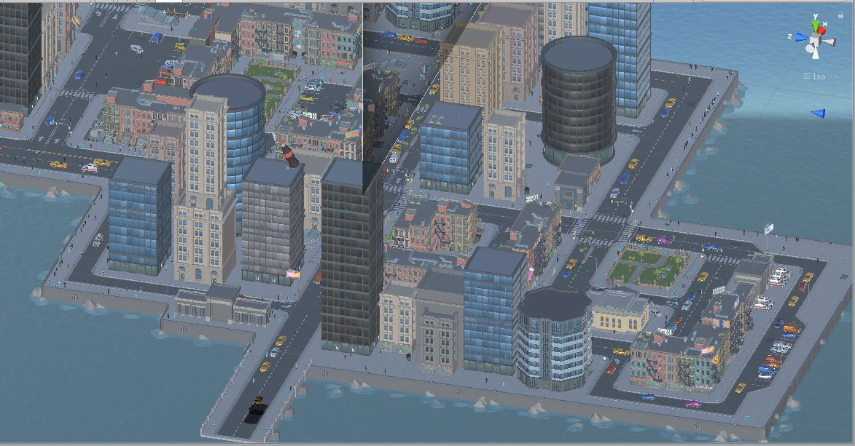
Environment

Slide 7
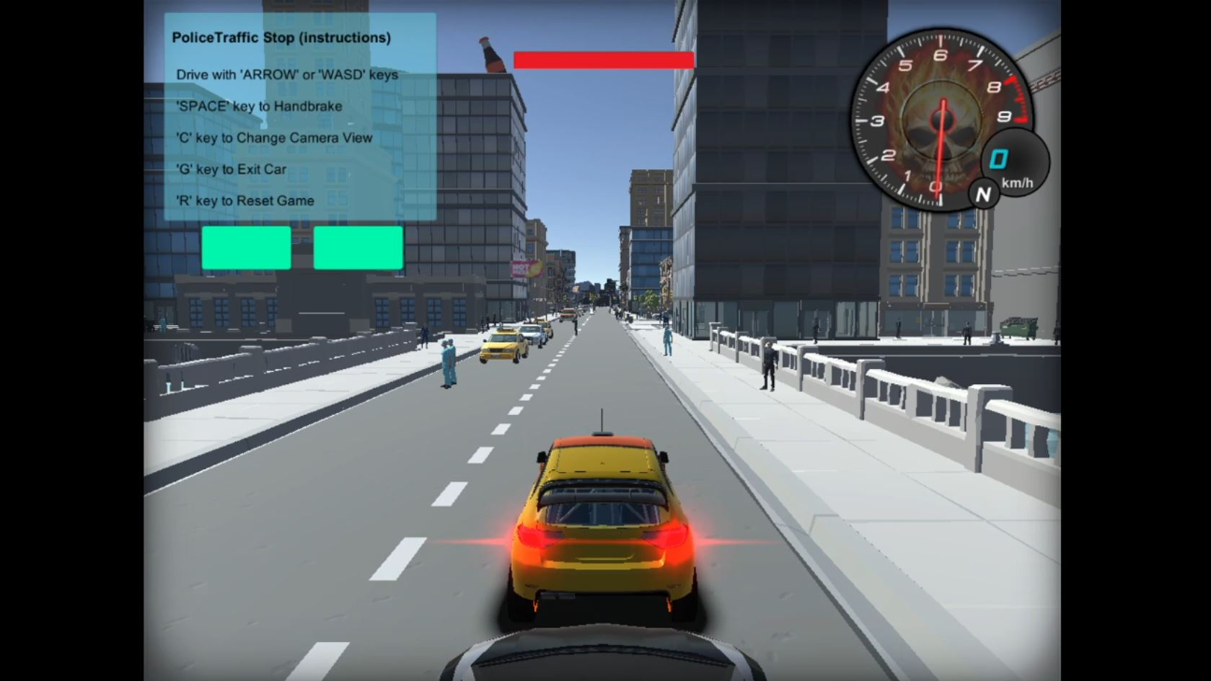
Graphic User Interface

Slide 8
Functionality
Vision: Use of textures and 3D models to provide detailed information.
Sound: Use of speech and ambient sounds to help provide information.
Animation: Use of at least three animated objects.
Interactivity: Use of at least three user-triggered events.
Sensors: Use at least three different types of sensors ( Proximity, Colliders).
Avatars: Use of custom and inbuilt avatars.

Slide 9
Functionality - Interactivity
Built on Unity3D functionality
User will be driving a car in a First Person Point of View (FPPOV)
User will navigate with mouse and WASD buttons on keyboard
Information and instructions would be displayed onscreen
User would encounter and avoid road hazards and traffic signs or loose health
User would encounter law enforcement and ordered to stop
Subsequent onscreen instructions would instruct user to make choices
User choice would determine good or bad outcome of the encounter
Good encounter would allow user to continue
Bad encounter would result in loss of life or death

Slide 10
Functionality - Sound
Background/ambient sound – City traffic audio attached to main camera
Car sound – Engine, Police Siren, Crash, Tires Screech
Law enforcement voice over commands (NI)
Use of player and law enforcement voice to provide interaction (male or female?) (NI)
Use of gunshot sound (NI)

Slide 11
Functionality - Animation
Animated Avatars – 500 autonomous avatars
Animated Cars
Animated Car Lights
Animated Speedometer
Animated Camera Views

Slide 12
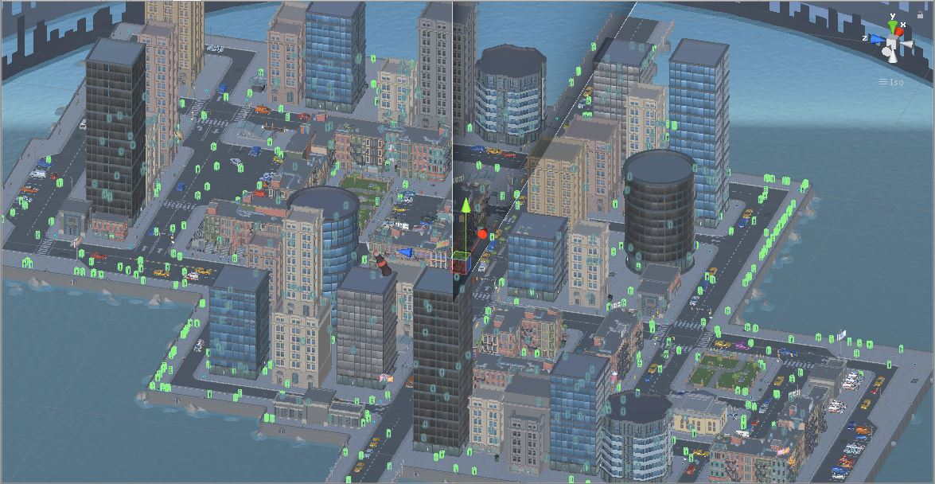
50o Avatars

Slide 13
Functionality - Sensors
Proximity sensors to monitor distance between other drivers and pedestrians
Proximity sensors to trigger police chase

Slide 14
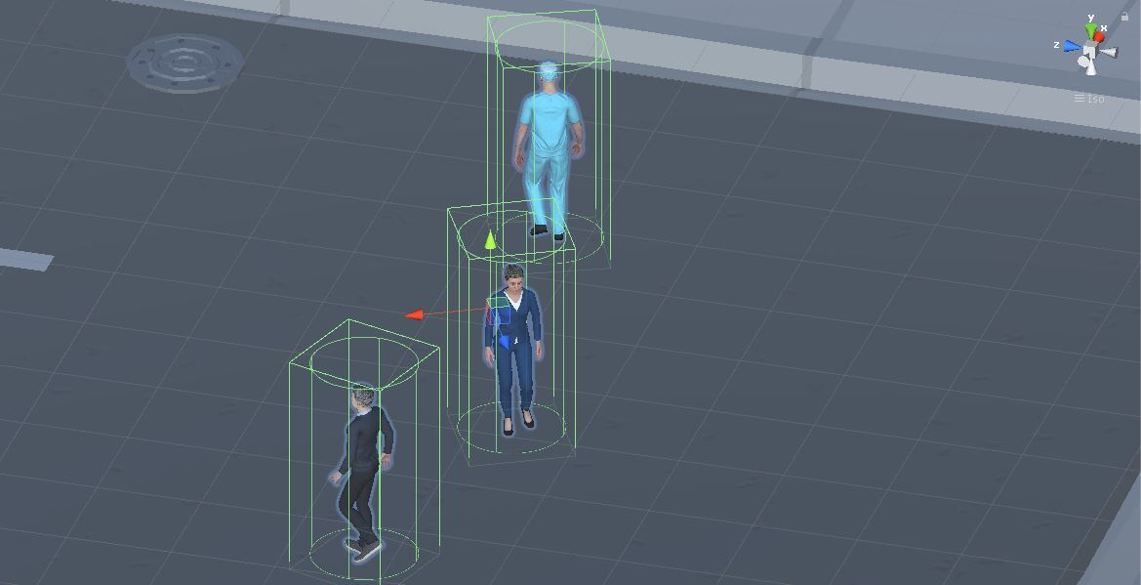
Avatar Sensors

Slide 15
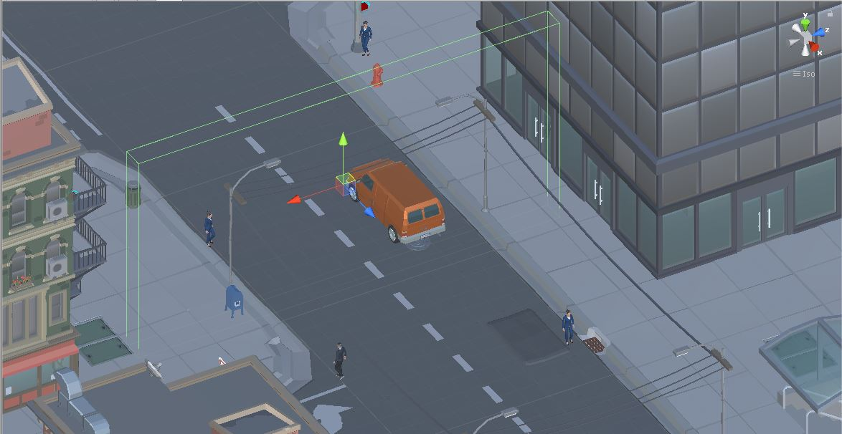
Police Chase Sensors

Slide 16
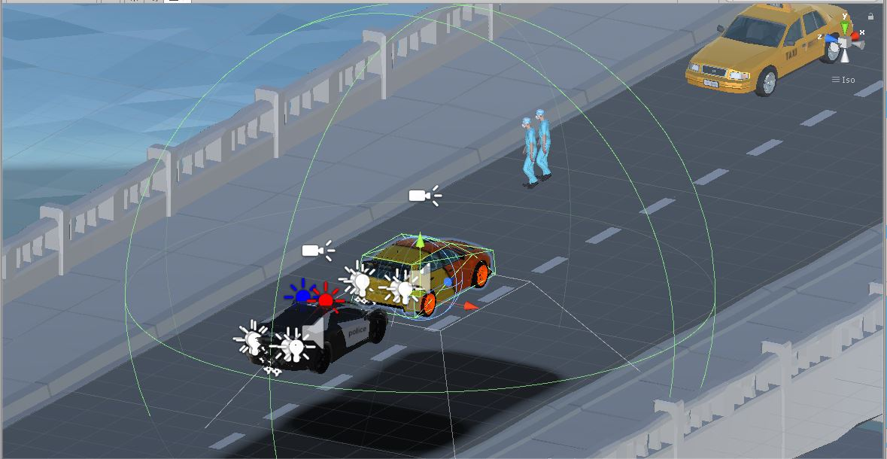
Police Shoot Sensor

Slide 17
3D Model Asset Sources
Advantageous use of pre-existing geometry and textures.
Online 3D Database – TurboSquid, 3D Warehouse, Unity Asset Store, CG Trader

Slide 18
Other Asset Sources
Sound (Royalty free) – Zapsplat, BBC, FreeSFX, Freesound
Animation (Royalty free) – Mixamo

Slide 19
Roles and Management Plan
Victor Ngoubayo – Programming, 3D Models, Sound
Swetha Thodupunori – Programming, 3D Models, Lights
Prince Ikegwuono – Programming, 3D Models, Animation

Slide 20
To Do List
Police car chase
Player run away and police foot chase
Police open fire
Police interview / interaction
Game Welcome and Game Over screen
Traffic Light System

Slide 21
THANK YOU ☺!

